Slide 1
British Airways
CUSTOMER Booking Completion Prediction
BY : PANUGANTI BHANU
JUNE 2025

Slide 2
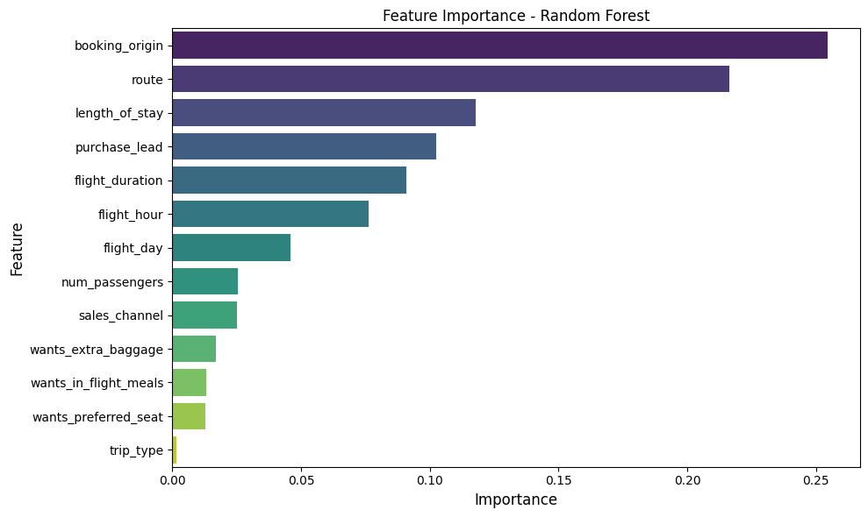
Booking Completion Prediction – Final Model Summary
Model Performance Feature Importance
Test Accuracy: 82.25%
Test ROC AUC: 0.7892
Cross-Validated Accuracy: 0.8272
Cross-Validated ROC AUC: 0.7914
Model Setup
Algorithm: Random Forest Classifier
Class imbalance: class_weight=‘balanced’ + SMOTENC
Feature Engineering – log transforms + Target Encoding + factorize
Classification Report
Class | Precision | Recall | F1-score
0 | 0.89 | 0.90 | 0.90
1 | 0.40 | 0.39 | 0.40
Accuracy |  |  | 0.82
The feature importance analysis shows that booking origin, route, length of stay and purchase lead are the most influential in predicting booking completion.
The model shows limited recall for completed bookings (class 1), indicating it may miss some genuine bookers. This is a trade-off due to class imbalance

